Slide 1
Substring and Array in Linux

Slide 2
Bash Substring
A substring is a sequence of characters within a string. Bash provides an option to extract the information from a string itself. You can extract the digits or a given string using several methods.
For example, "welcome you on Javatpoint." is a substring of "We welcome you on Javatpoint."
Syntax
The command for the extraction of substring is a build-in bash command, and so it is very good to use for performance perspective.
The syntax of the substring extraction can be defined as:
${variable:offset:length}

Slide 3
Variable is the variable name that contains a string.
Offset is used to specify the position from where to start the extraction of a string.
Length is used to specify the range of the characters to be executed from the offset.

Slide 4
Example 1: To Extract till Specific Characters from Starting
#!/bin/bash
#Script to extract first 10 characters of a string
echo "String: We welcome you on Javatpoint."
str="We welcome you on Javatpoint."
echo "Total characters in a String: ${#str} "
substr="${str:0:10}"
echo "Substring: $substr"
echo "Total characters in Substring: ${#substr} "

Slide 5
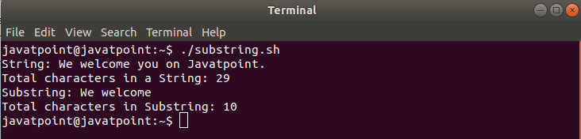

Slide 6
Example 2: To Extract from Specific Character onwards
#!/bin/bash
#Script to print from 11th character onwards
str="We welcome you on Javatpoint."
substr="${str:11}"
echo "$substr"
Output
you on Javatpoint.

Slide 7
Example 3: To Extract a Single Character
#!/bin/bash
#Script to print 11th character of a String
str="We welcome you on Javatpoint."
substr="${str:11:1}"
echo "$substr"
Output

Slide 8
Example 4: To Extract the specific characters from last
#!/bin/bash
#Script to extract 11 characters from last
str="We welcome you on Javatpoint."
substr="${str:(-11)}"
echo "$substr"
Output

Slide 9
Bash Concatenate String
In bash scripting, we can add or join two or more strings together, which is known as string concatenation. It is one of the common requirement for any programming language. A special character or built-in function is applied to perform string concatenation. However, Bash does not contain any built-in function to combine string data or variables. The easiest method to perform string concatenation in bash is to write variables side by side.
For example, assume that we have two strings (i.e., "welcome" & "to javatpoint"), and we join both the strings together and a new string ("welcome to javatpoint") is created. This concept is referred to as String Concatenation.

Slide 10
Example 1: Write Variables Side by Side
#!/bin/bash
#Script to Concatenate Strings
#Declaring the first String
str1="We welcome you"
#Declaring the Second String
str2=" on Javatpoint."
#Combining first and second string
str3="$str1$str2"
#Printing a new string by combining both
echo $str3

Slide 11
Example 2: Using Double Quotes
#!/bin/bash
#Script to Concatenate Strings
#Declaring String Variable
str="We welcome you"
#Add the variable within the string
echo "$str on Javatpoint."

Slide 12
Example 3: Using Append Operator with Loop
#!/bin/bash
echo "Printing the name of the programming languages"
#Initializing the variable before combining
lang=""
#for loop for reading the list
for value in 'java''python''C''C++';
do
lang+="$value " #Combining the list values using append operator
done
#Printing the combined values
echo "$lang"

Slide 13
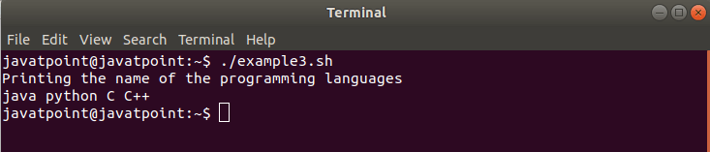

Slide 14
Example 4: Using the Printf Function
#!/bin/bash
str="Welcome"
printf -v new_str "$str to Javatpoint."
echo $new_str

Slide 15
Example 5: Using Literal Strings
#!/bin/bash
str="Welcome to"
newstr="${str} Javatpoint."
echo "$newstr"

Slide 16
Example 6: Using Underscore
#!/bin/bash
str1="Hello"
str2="World!"
echo "${str1}_${str2}"

Slide 17
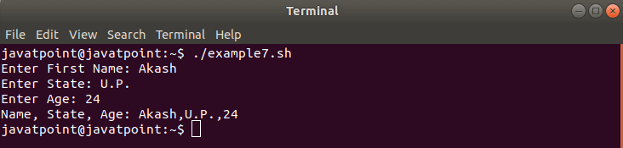
Example 7: Using any Character
#!/bin/bash
#String Concatenation by Character (,) with User Input
read -p "Enter First Name: " name
read -p "Enter State: " state
read -p "Enter Age: " age
combine="$name,$state,$age"
echo "Name, State, Age: $combine"

Slide 18
Bash Array
An array can be defined as a collection of similar type of elements. Unlike most of the programming languages, arrays in bash scripting need not be the collection of similar elements. Since Bash does not discriminate the string from a number, an array may contain both strings and numbers.
Bash does not provide support for the multidimensional arrays; we cannot have the elements which are arrays in themself. Bash provides support for one-dimensional numerically indexed arrays as well as associative arrays. To access the numerically indexed array from the last, we can use negative indices. The index of '-1' will be considered as a reference for the last element. We can use several elements in an array.

Slide 19
Bash Array Declaration
Creating Numerically Indexed Arrays
We can use any variable as an indexed array without declaring it.
To explicitly declare a variable as a Bash Array, use the keyword 'declare' and the syntax can be defined as:
declare -a ARRAY_NAME
where,
ARRAY_NAME indicates the name that we would assign to the array.

Slide 20
A general method to create an indexed array can be defined in the following form:
ARRAY_NAME[index_1]=value_1
ARRAY_NAME[index_2]=value_2
ARRAY_NAME[index_n]=value_n
where keyword 'index' is used to define positive integers.

Slide 21
declare -a ARRAY_NAME
ARRAY_NAME=(
[index_foo]=value_foo
[index_bar]=value_bar
[index_xyz]=value_xyz
)

Slide 22
#!/bin/bash
#Script to print an element of an array with an index of 2
#declaring the array
declare -a example_array = ( "Welcome""To""Javatpoint" )
#printing the element with index of 2
echo ${example_array[2]}

Slide 23
If we use @ or * in the place of a specified index, it will expand to all members of the array. To print all the elements, we can use the following form:
#Printing all the elements
echo "${example_array[@]}"

Slide 24
for i in "${example_array[@]}"; do echo "$i";done
for i in "${example_array[*]}"; do echo "$i";done

Slide 25
Printing the Keys of an Array
declare -a example_array =( "Welcome""To""Javatpoint" )
#Printing the Keys
echo "${!example_array[@]}"
Finding Array Length
We can count the number of elements contained in the array by using the following form:
${#ARRAY_NAME[@]}
echo "The array contains ${#example_array[@]} elements"

Slide 26
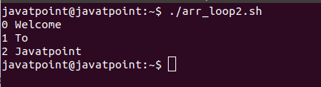
#!/bin/bash
#Script to loop through an array in C-style
declare -a example_array=( "Welcome""To""Javatpoint" )
#Length of the Array
length=${#example_array[@]}
#Array Loop
for (( i=0; i < ${length}; i++ ))
do
echo $i ${example_array[$i]}
done

Slide 27
Adding Elements to an Array
We have an option to add elements to an indexed or associative array by specifying their index or associative key respectively. To add the new element to an array in bash, we can use the following form:
ARRAY_NAME[index_n]="New Element"

Slide 28
#Declaring an array
declare -a example_array=( "Java""Python""PHP""HTML" )
#Adding new element
example_array[4]="JavaScript"
#Printing all the elements
echo "${example_array[@]}"

Slide 29
#!/bin/bash
#Declaring the Array
declare -a example_array=( "Java""Python""PHP" )
#Adding new elements
example_array+=( JavaScript CSS SQL )
#Printing all the elements
echo "${example_array[@]}"

Slide 30
Updating Array Element
#!/bin/bash
#Script to update array element
#Declaring the array
declare -a example_array=( "We""welcome""you""on""SSSIT" )
#Updating the Array Element
example_array[4]=Javatpoint
#Printig all the elements of the Array
echo ${example_array[@]}

Slide 31
Deleting an Element from an Array
If we want to delete the element from the array, we have to know its index or key in case of an associative array. An element can be removed by using the 'unset' command:
unset ARRAY_NAME[index]

Slide 32
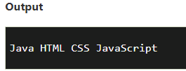
#!/bin/bash
#Script to delete the element from the array
#Declaring the array
declare -a example_array=( "Java""Python""HTML""CSS""JavaScript" )
#Removing the element
unset example_array[1]
#Printing all the elements after deletion
echo "${example_array[@]}"

Slide 33

echo ${!example_array[@]}

Slide 34
Deleting the Entire Array
Deleting an entire array is a very simple task. It can be performed by passing the array name as an argument to the 'unset' command without specifying the index or key.
#Declaring the Array
declare -a example_array = ( "Java""Python""HTML“ "CSS""JavaScript" )
#Deleting Entire Array
unset example_array

Slide 35
Slice Array Elements
Bash arrays can also be sliced from a given starting index to the ending index.
To slice an array from starting index 'm' to an ending index 'n', we can use the following syntax:
SLICED_ARRAY=(${ARRAY_NAME[@]:m:n}")

Slide 36
#!/bin/bash
#Script to slice Array Element from index 1 to index 3
#Declaring the Array
example_array=( "Java""Python""HTML""CSS""JavaScript" )
#Slicing the Array
sliced_array=("${example_array[@]:1:3}")
#Applying for loop to iterate over each element in Array
for i in "${sliced_array[@]}"
do
echo $i
done

Slide 37
